Slide 1
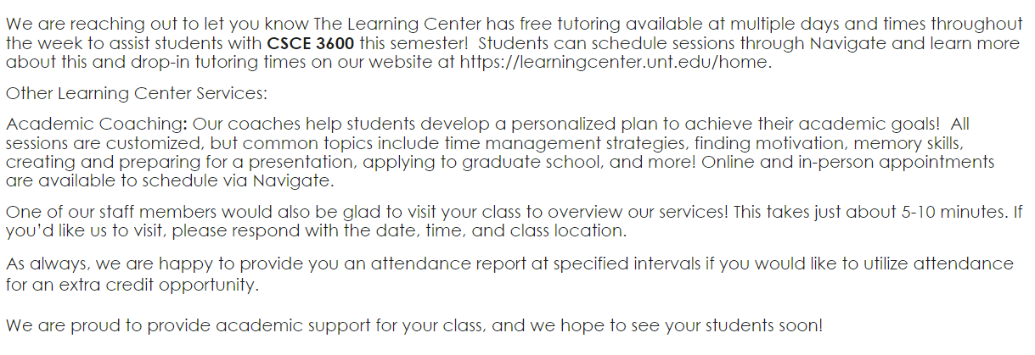
Learning support for 3600

Slide 2
CSCE 3600 Principles of Systems Programming GitLab and Team Development
University of North Texas

Slide 3

Working in Teams (A Simplified, Modified View of Scrum)

Slide 4

Agile Framework
Agile approach
Adaptive, empirical process
Small repeating cycles
Short-term planning with constant feedback, inspection, and adaptation
Fail-early lifecycle
Agile philosophy
Individuals and interactions over processes and tools
Working software over comprehensive documentation
Customer collaboration over contract negotiation
Responding to change over following a plan

Slide 5
What is Scrum?
Scrum is a lightweight, iterative, and incremental agile framework for managing product development
Designed for teams of 3 – 9 members
Break work into actions that can be completed in timeboxed iterations called sprints, lasting between 2 – 4 weeks
Progress tracked and re-planned in 15-minute stand-up meetings, called daily scrums
How can we use Scrum for our Major Assignments?
Scaled down
Teams of 3 or 4 (preferably 4)
Weekly sprints will consist of the deliverable (working solution) by the assignment due date (major assignments typically due in 2 – 4 weeks)
Daily scrums may not be feasible due to school/work schedules
Instead, teams can meet for 15 minutes 2 – 4 times/week in recitation, time given at end of class, and other times

Slide 6
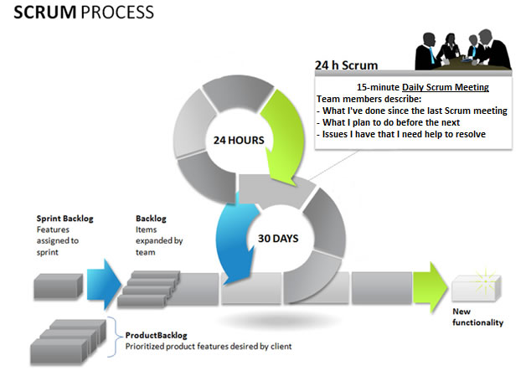
Scrum Process
15 Minute Frequent Scrum Meetings
Team members describe:
What I’ve done since last Scrum meeting
What I plan to do before the next
Issues I have that I need help to resolve
Weekly Sprints
Short duration milestones
1 day sprint planning, 5 days work, and 1 day of sprint review
Each sprint delivers progressively iterative working solution
2 – 4 /week
Sprint Backlog
Features
assigned to
sprint
Backlog
Items
expanded by
team
Product is designed, coded, and tested during the sprint
weekly
Assignment
solution
Product Backlog
Prioritized product features

Slide 7


Scrum Team
ScrumMaster
Combination of Coach, Fixer, and Gatekeeper
Makes sure the project is progressing smoothly, keeps team focused
Product Owner
Prioritizes the product backlog (i.e., requirements), but team determines sequence in which they will develop
Inspects and adapts features as needed
Team
Everyone, including ScrumMaster and Product Owner
Self-organizing (based on strengths, not lone-wolf)
Does the work (analysis, design, code, test, …) in iterations called sprints

Slide 8
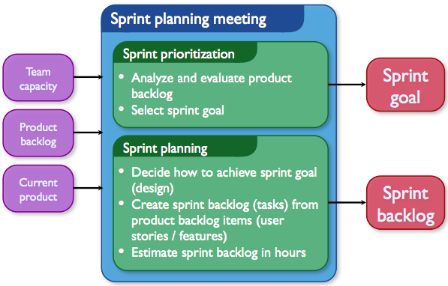
Sprint Planning

Slide 9
GitLab Overview

Slide 10
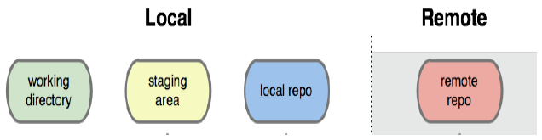
What is Git?
Git is a version control system
Developed as a repository system for both local and remote changes
Allows teammates to work simultaneously on a project
Tracks each commit, allowing for detailed documentation of the project along every step
Allows for advanced merging and branching operations

Slide 11
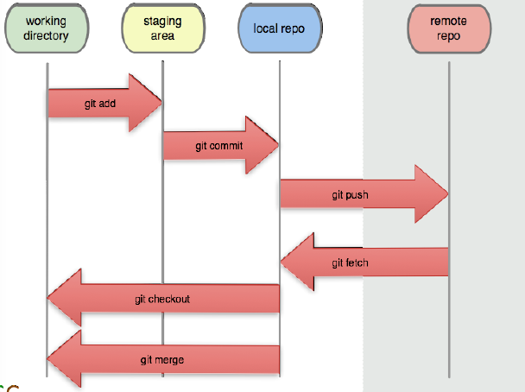
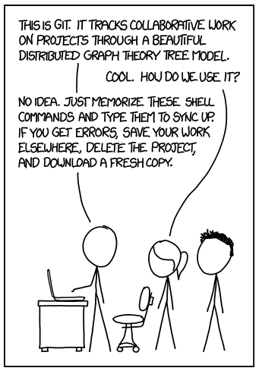
What is Git?
Unmodified/modified
files
Staged
files
Committed
files
http://xkcd.com/1597/

Slide 12
What is GitLab?
GitLab is a web interface for Git
Provides additional features on top of Git repository
Allows for access to the repository from a web browser
Issue and milestone tracking implemented
Support for attachments and code snippets
Integration of a wiki and a wall for project documentation
Each user is able to submit a generated SSH key to uniquely identify the submitter and machine
Commits are done through an SSH shell, using the generated public key for authentication

Slide 13
What is GitLab?
GitLab is a repository hosting manager tool developed by GitLab Inc, used for Software Development Process.
It provides ways to streamline your collaborative workflow for completing the SDLC
FEATURES:
Open-source community edition repository management platform
Easy Maintaining of repository on a server
Offers tools like Group Milestones, Time Tracking and Issue Tracker, etc. for effective software development
More Spontaneous User interface and authentication features
User Permission and Branch protection are enhanced

Slide 14
Using GitLab at UNT
The Gitlab server used in CSE is csegitlab.engineering.unt.edu
This server is only accessible on the UNT network (either being physically on UNT campus or by using the VPN)
You will receive a confirmation email when groups and accounts are created for each one of you.
The confirmation email will provide a link to confirm your account https://csegitlab.engineering.unt.edu/users/confirmation
You must use your@my.unt.edu email to confirm your account and then you should be able to log in

Slide 15
GitLab Setup Overview
Preview setup in GitLab
Generation of SSH key
Copy of SSH key to clipboard
GitLab connection
Add SSH key in GitLab
GitLab setup on your machine
Copy URL of the repository
Initial setup
Steps to create a new file and upload to GitLab
Steps to modify a file and upload to GitLab
Handling merge conflicts
Other helpful commands
Only needs to be done once
Notes:
https://githowto.com/create_a_project

Slide 16
Generate and Copy SSH Key
$ ssh-keygen
Generating public/private rsa key pair.
Enter file in which to save the key (/home/sp1568/.ssh/id_rsa):
Enter passphrase (empty for no passphrase):
Enter same passphrase again:
Your identification has been saved in /home/sp1568/.ssh/id_rsa.
Your public key has been saved in /home/sp1568/.ssh/id_rsa.pub.
The key fingerprint is:
...
$ cat ~/.ssh/id_rsa.pub
...
Just hit [ENTER]
Copy the entire SSH key
You will paste this in GitLab (see next slides)

Slide 17

Login and Add SSH Key
Connect to GitLab Server
URL: apollo.cse.unt.edu
GitLab Login Credentials: EUID / password
You should reset your password using the link that you receive when your account gets created
Adding SSH Key in GitLab
If necessary, go to Settings under Public Avatar icon (top right of browser)
Select SSH Keys under User Settings
Paste the SSH key (from previous slide) in text box
Select Add key button

Slide 18
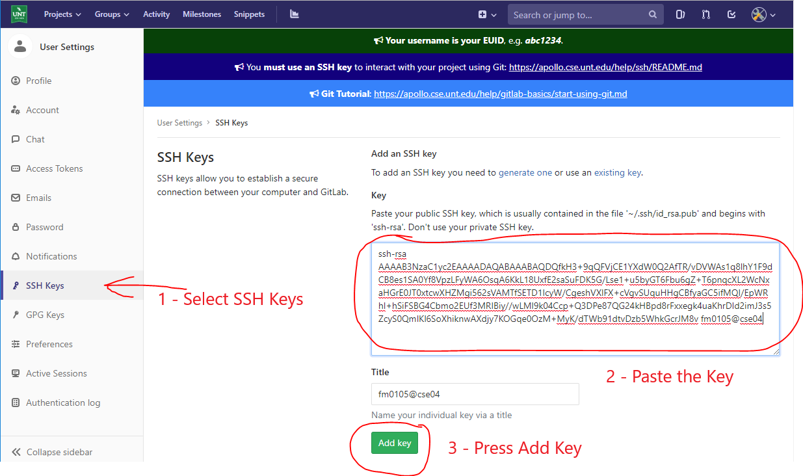
Login and Add SSH Key
https://csegitlab.engineering.unt.edu/users/sign_in

Slide 19
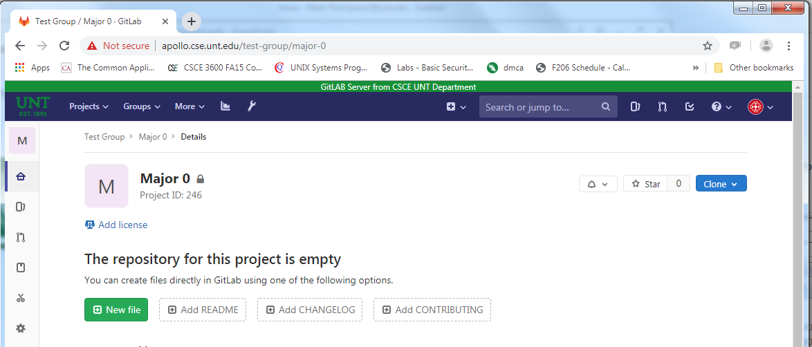
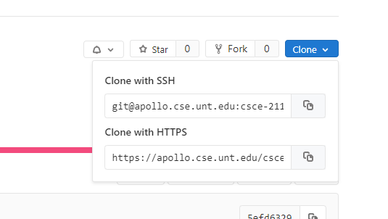
Copy URL of Repository
Copying link has been moved to blue “Clone” popup button
Press here to copy

Slide 20
Initial Setup on CSE Machine
Login to one of the CSE machines
Create a directory with your project name
Open the directory and run the following git commands:
$ git init
...
$ git clone <URL>
...
You should now have a directory with your repository name.
These commands will initialize a git directory, pull down all the data for that repository, and check out a working copy of the latest version
This will be your master branch
Creates a new local repository
Downloads a project and its entire version history
This is the URL copied on previous slide

Slide 21
Initial Setup on CSE Machine
Setup your identity, which is used by every git commit
$ git config --global user.name "Your Name"
...
$ git config --global user.email name@my.unt.edu
...
Sets the name you want attached to your commit transactions
Sets the e-mail you want attached to your commit transactions

Slide 22
GitLab Help Options
Three ways to get more information about a command from the manpage
help <command>
<command> --help
man git-<command>
<command> -h will pull up a quick reference version of the manpage

Slide 23
Status Report
status will report which files have been modified, staged, and untracked
Using -s gives the short report
?? indicates a file is untracked
'' indicates a file is unmodified
A indicates a new file has been added to the staging area
M indicates a file has been modified
There are actually two columns!
Left column is the status of the staging area version of the file
Right column is the status of the working directory version of the file

Slide 24
Committed File Options
Sometimes mistakes are made when staging and committing, so there are a few commands to help with this
commit with the --amend flag allows you to update the most recent commit
Just be careful about rewriting history!
reset HEAD removes all files from staging

Slide 25
Moving and Removing Files
We can remove files in one of two ways
We can just delete the file using rm
Or we can remove it from the repository using rm
We can also stop files from being tracked using rm with --cached flag
Renaming a file can be performed using the mv command

Slide 26
Ignoring Files
If you want to keep files out of the status listing or staging you can create a .gitignore file
Uses standard globbing patterns (i.e., similar to regular expressions)
Each line represents a pattern used to exclude specific files
https://github.com/github/gitignore has a very comprehensive collection of .gitignore files for different situations

Slide 27
Tagging Files
Sometimes it is helpful to name certain commits, such as v1.0 or v2.0
Use tag to both list the named version as well as to name new ones!
-a generates annotated tags with a message
Otherwise, just naming the current version will suffice
You need a portion of the checksum to name earlier commits
-d will delete a tag as well

Slide 28
Working Remotely
commit only affects the local repository
fetch, push, pull, branch are needed to modify the remote repository
Along with merge and diff
Keep in mind, this is a bit more complicated, but very important when developing code with a team

Slide 29
Multiple Users
Unorganized push and pull requests may cause problems and some push requests may be rejected!
We need to use and understand branching!
Also, make sure you always test your branch before you move it back to the remote repository!
DON’T PUSH BROKEN CODE!

Slide 30
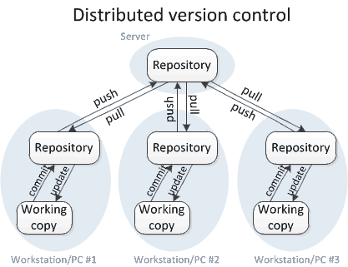
Version Control through Branching
A way to write code without affecting the rest of your team
Merge branches to integrate your changes
Why use branching?
So you can push unstable code
Work independently
Still use remote version control
Only merge stable/functioning code
What if everyone pushes to the same branch?

Slide 31

Branching
New commits are only added to the current branch
Can implement experimental code without affecting others
When the life of the branch is over
Merge it into the primary codebase
Branching is crucial on large teams

Slide 32

Merging
Once the changes are complete and stable
Merge the branch back to the codebase
Typically:
Initiate a pull request
If your team performs code reviews
It will likely happen here
Choose how to merge the code
Conflict resolution can be time consuming
Helps to coordinate with your team and limit editing the same files

Slide 33
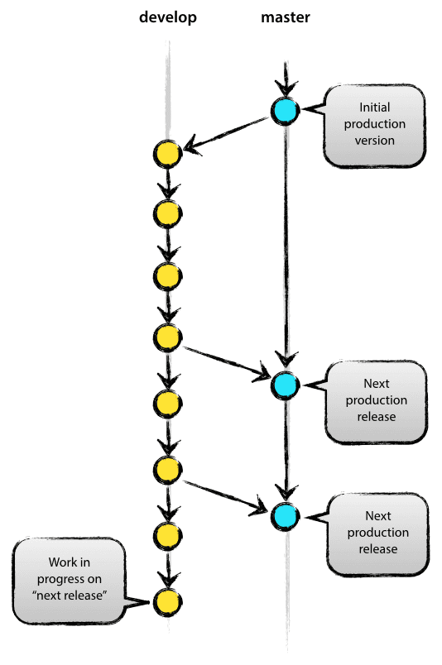
A (Suggested) Branching Model
Two primary branches: Master and Develop
Master is the default branch in git
Use for stable releases
Create develop branch
Use for untested code
Primary working branch for the team
Contains the latest features
Close to a release
Test develop branch for stability
Merge commits in develop into master
Test and release master
Continue to code on develop through the release

Slide 34
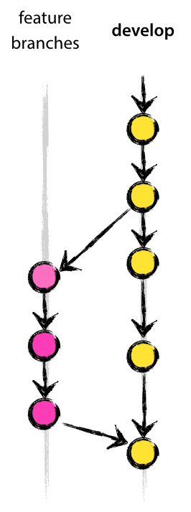
Feature Branch
Branch off of develop
Primary working branches for individual(s)
When new feature is finished
Merge into develop
Code reviews (if applicable)
Hope it doesn’t break develop (it might)
Temporary branches
Can be many feature branches being developed in parallel

Slide 35
Uploading New File to GitLab
Create a new file in the project
Stage the added file(s)
$ git add <filename>
...
Commit the changes after staging
$ git commit –m "Your commit reason"
...
Once you have committed, you need to pull the latest from the remote branch and then push to the server (i.e., origin)
$ git pull
...
$ git push origin master
...
Only after this push command will your file(s) be added to the GitLab repository (be sure to confirm this)

Slide 36
Upload Modified File to GitLab
Download actual version of repository files to your directory
$ git pull
...
Create new branch (usually with your name) to identify as different from the master branch
$ git branch <branch_name>
...
Switch from current branch to new branch
$ git checkout <branch_name>
...
Check the status of the branch
$ git status
...
Alternatively: git checkout <filename>
Shows the current branch and the status of all files

Slide 37
Upload Modified File to GitLab
Now you can modify the file (or add new files)
Once all changes are made in your new branch
$ git add .
...
Commit the changes after staging
$ git commit –m "Your commit reason”
...
Switch back to master branch and merge new branch
$ git checkout master
...
Merge new branch to master branch
$ git merge <branch_name>
...

Slide 38
Upload Modified File to GitLab
Delete your new branch (since now included in master)
$ git branch –d <branch_name>
...
Once the master branch is ready, you need to pull the latest from the remote branch and then push to the server (i.e., origin)
$ git pull
...
$ git push origin master
...
Only after this push command will your file(s) be added to the GitLab repository (be sure to confirm this)

Slide 39
Handling Merge Conflicts
Sometimes, we get conflicts while merging
Usually occurs if change same part of same file in two different user branches
Error message example when conflicts on merge
Check which files not merged when conflict
$ git status
...
Once all conflicts resolved, use git commit to finalize the merge commit
$ git merge iss53
Auto-merging index.html
CONFLICT (content): Merge conflict in index.html
Automatic merge failed; fix conflicts and then commit the result.
Use git mergetool to find out more details about conflict

Slide 40
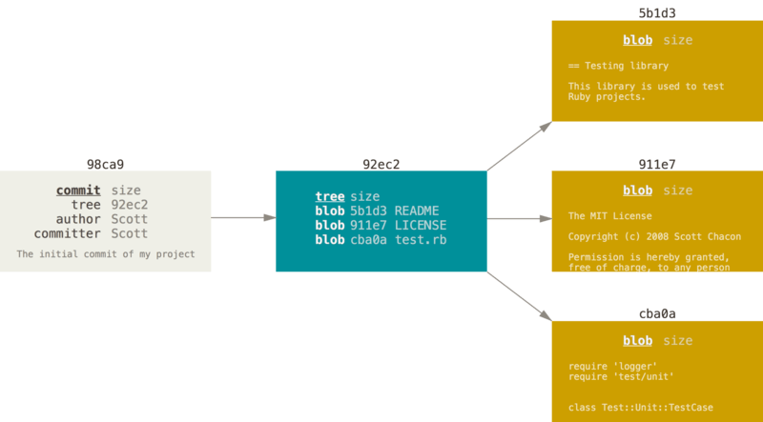
Branch Manager
Snapshots are formed in a basic file hierarchy
Commit 98ca9, with one tree 92ec2 keeping track of three files, 5b1d3, 911e7, cba0a
Snapshots record the state of the items within a project or branch at a specific point in time.

Slide 41
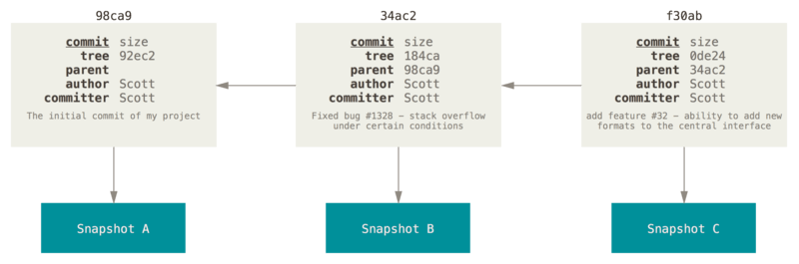
Branch Manager
Snapshots themselves are stored a bit like a Linked List using pointers
Now we have three commits and thus three snapshots
Each has a hash id (SHA-1)

Slide 42
Branch Manager
A branch is another pointer representing which snapshot you are working with
master is the default initial branch name, but you can always change that
The main branch, master in this case, is referred to as the trunk
master
98ca9
34ac2
f30ab

Slide 43
Branch Manager
In Git, the HEAD pointer always points to the branch you are current working on
Works a bit differently with other systems.
HEAD
master
98ca9
34ac2
f30ab

Slide 44
Branching Out
branch command creates a new named pointer pointing to your current snapshot by default
Eventually these need to be merged with your trunk (i.e., master in this case) to become part of the main code development
HEAD
master
98ca9
34ac2
f30ab
dev

Slide 45
Branching Out
checkout command changes which branch pointer you are currently working on
Using the –b option on checkout will create the branch and swap you to it
master
98ca9
34ac2
f30ab
dev
HEAD

Slide 46
Branching Out
Commits move only the current branch (i.e. the branch that HEAD is pointing to) pointer ahead
master
98ca9
34ac2
f30ab
190a3
dev
HEAD

Slide 47
Branching Out
The branch command by itself will list all of the current branches
Knowing the names of branches allows us to swap to other existing branches using checkout
HEAD
master
98ca9
34ac2
f30ab
190a3
dev

Slide 48
Merging
After changes are made and tested they need to be merged back into master
First we checkout master
Then we merge with the edited branch
HEAD
master
98ca9
34ac2
f30ab
190a3
dev

Slide 49
Merging
After changes are made and tested they need to be merged back into master
First we checkout master
Then we merge with the edited branch
Finally, we delete the extra branch with the –d option on branch
Known as a fast-forward merge
HEAD
master
98ca9
34ac2
f30ab
190a3

Slide 50
Diverging
But what if multiple branches start committing different changes?
Now we have to be more careful
We will need a three-way merge
HEAD
master
190a3
98ca9
34ac2
f30ab
893cf
dev

Slide 51
Conflicting Information
Conflicts are individual lines that are different between the files e.g. file1.txt and file2.txt
Some must be resolved manually
If a line is altered in one file but not the other, the altered line is used
If a line is altered in both files, merge will mark it as such
<<<<<<<< HEAD
Input:file1.txt
===========
Input:file2.txt
>>>>>>>>>>> otherBranch

Slide 52
Conflict Resolution
Can edit the file or use mergetool
Once the conflict is resolved, commit to store the changes
HEAD
master
190a3
a38de
98ca9
34ac2
f30ab
893cf
dev

Slide 53
Conflict Resolution
Can edit the file or use mergetool
Once the conflict is resolved, commit to store the changes
You can also delete the other branch
HEAD
master
190a3
a38de
98ca9
34ac2
f30ab
893cf
But what about branches on the remote repository?

Slide 54
Fetch and Pull
To access updates that may have been pushed to the remote repository, we can use fetch and pull
pull is the same a fetch, but just with an implied merge
Similar to how clone performs all of the other setup commands
fetch and pull by default download all branches
You can always specify a particular branch though by including the name
Downloaded branches may be named origin/<branch name>
No need to delete origin/<branch name>

Slide 55
Back to the Past – how version control is enabled
Creating commits along branches helps preserve previous versions of the system
Need a way to return to previous versions
checkout allows moving to a previous version
checkout can be performed using the tag or checksum of any commit
This results in the detached HEAD state

Slide 56
Yours, Mine, and Ours
Once in a previous version, we can use branching and merging to overwrite the latest version on HEAD
First, branch from the old version
Make sure you checkout onto the new branch
Then merge –s ours to your desired branch
ours is a merge strategy that uses only the current branch’s version
checkout your desired branch and then merge with the old version

Slide 57
Other Helpful Commands
To see all changes made, but not yet staged
$ git diff
...
To see all changes made that will go into next commit
$ git diff --staged
...
To remove a file from GitLab
$ rm <filename>
$ git rm <filename>
...
To list the version history for the current branch
$ git log
...

Slide 58
Other Helpful Commands (cont’d)
To redo a commit
$ git commit --amend
...
To unstage a staged file
$ git reset HEAD <filename>
...
To unmodify a modified file
$ git checkout <filename>
...
Make the additional changes you missed, stage them, and then run this command

Slide 59
Useful Links and References
https://git-scm.com/book/en/v2/Getting-Started-About-Version-Control
https://about.gitlab.com/2014/09/29/gitlab-flow/
https://docs.gitlab.com/ee/gitlab-basics/command-line-commands.html
http://git-scm.com/doc

